Slide 1
Project Title: Gamified Recycling App ♻️
Tagline: “Recycle Right. Play Green. Win Rewards.”
Team Name & Members :
Vaishnavi Singh
Sarthak Kumar
Satyendra Bharti
Jahnavi Singh

Slide 2
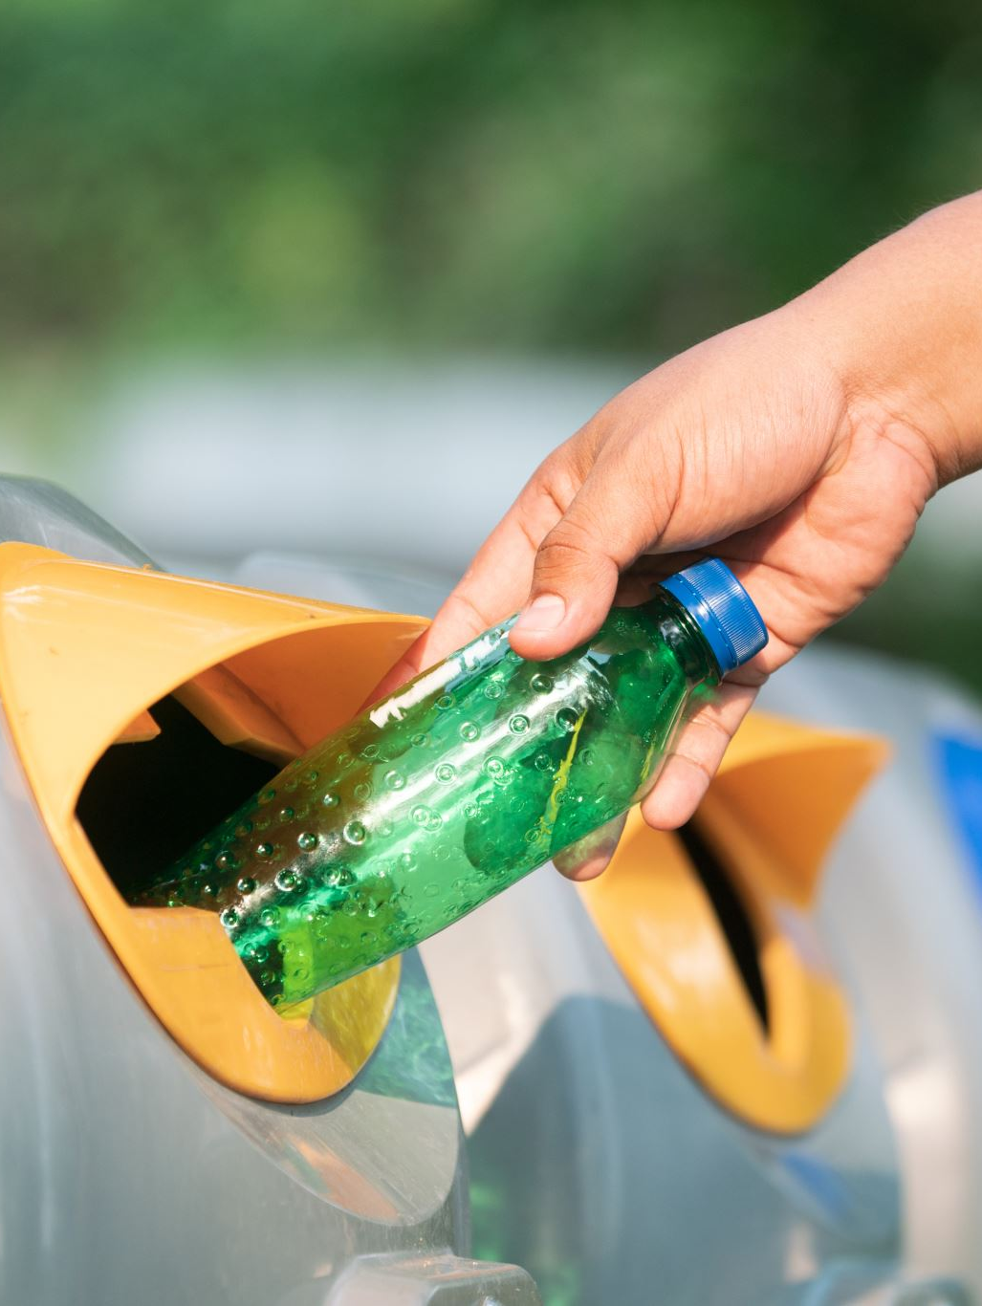
Problem Statement
Waste segregation is not followed properly.
People lack awareness of the right disposal methods.
Recycling is seen as boring with no personal motivation.
This leads to low recycling efficiency and more landfill waste.

Slide 3
Proposed Solution
A mobile/web app that makes recycling fun and rewarding.
Users scan barcodes/QR or take a photo of waste items.
App identifies the correct bin (plastic, paper, organic, metal).
Users earn points, badges, and streaks for correct recycling.
Rewards can be redeemed for coupons or eco-friendly perks.

Slide 4
Key Features
Waste identification (barcode/photo scan).
Points, levels & achievement badges .
Daily recycling streaks .
Leaderboards for friendly competition.
Redeemable rewards (discounts/coupons).

Slide 5
Technology Stack
Frontend: HTML, CSS, JavaScript (simple web app).
Backend: Firebase (authentication & database).
Gamification Logic: JavaScript for points, badges, leaderboards.
Future Add-on: Machine Learning (TensorFlow.js for image recognition).

Slide 6
Impact
Promotes correct recycling behavior.
Reduces waste mismanagement & landfills.
Makes sustainability engaging through gamification.
Encourages youth/communities to adopt eco-conscious habits.

Slide 7
Future Scope
Integrate with municipal waste systems for real-time recycling stats.
Partner with local stores/colleges for redeemable eco-rewards.
Expand into hostels, universities, and smart cities.
Add AI-powered waste recognition for better user experience.

